Slide 1
IMDB Movie Dataset Exploratory Analysis
Lakshya Kumar
Pat Nguyen
Mason DePaoli
Chau Pham
Sankarshan Chaudhari

Slide 2
Dataset Description
IMDB Movie Dataset
This is a dataset with raw data pulled from the IMDB website, containing important information of 5043 movies with 28 variables
director_name - first and last name of the director that directed the said movie
num_critic_for_reviews - the number of critics that reviewed the movie
duration - how long the movie was (in minutes)
director_facebook_likes - the number of likes the director of the movie had on Facebook
actor_3_facebook_likes - number of likes the third leading actor of the movie had on Facebook
actor_2_name - first and last name of the second leading actor
actor_1_facebook_likes - number of likes the leading actor of the movie had on Facebook
gross - the income the movie made after costs of productions were subtracted (gross income)
genres - the specific genre or genres the movie was
actor_1_name - first and last name of the leading actor
movie_title - the title of the movie
num_voted_users - a count of the number of IMDB users that voted on that specific movie
cast_total_facebook_likes - combined amount of facebook likes for everyone in the cast of the movie
actor_3_name - first and last name of the second leading actor
facenumber_in_poster - the number of faces that were shown in the main movie poster
plot_keywords - keywords that describe the plot of the movie (one word and/or a couple words)
movie_imdb_link - a URL to the IMDB page of that specific movie
num_user_for_reviews - the number of IMDB users that reviewed the movie on the IMDB website
language - the language spoken in the movie
country - the country that the movie was produced in
content_rating - a rating for audiences to gage how appropriate the movie might be for them
budget - the amount of money spent to produce the movie
title_year - the year that the movie was released
actor_2_facebook_likes - number of likes the second leading actor of the movie had on Facebook
imdb_score - the score (out of 10) that the movie received on IMDB
aspect_ratio - the aspect ratio that the movie was released in
movie_facebook_likes - the number of likes the movie had on Facebook

Slide 3
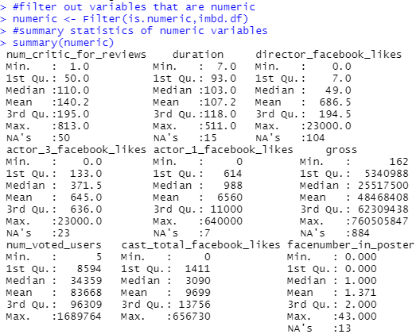
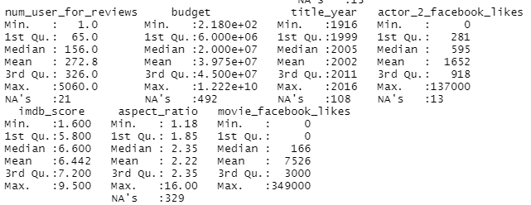
Summary Statistics Table
After filtering IMDB.df with only numeric variables, we can see that there are 16 numeric variables out of 28 variables.
Some variables have missing data (for example: the duration have 15 records missing data). Additionally, some variables have error in their data. This will be discuss in detail in the next slides.

Slide 4
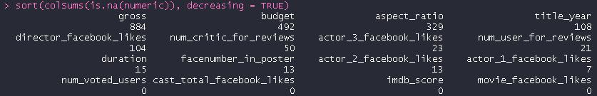
Missing Data from Variables
numeric <- Filter(is.numeric,IMDB.df)
There are a total of 28 variables. 16 of them are numeric
sort(colSums(is.na(numeric)), decreasing = TRUE)
Below is the code we ran to find the missing data points for all numeric variables
There are a total of 2059 missing values
The amount of missing data values from each numeric variable in the descending order is shown below

Slide 5
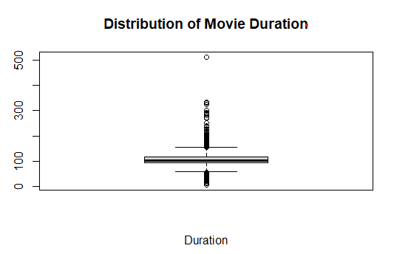
Variables Containing Outliers
There are 9 variables with outstanding outliers . We evaluate by comparing the max value with the 3rd quartile as well as looking at the box plot visualization. Below is a boxplot example of movie duration.
9 variables with outliers are:
gross
budget
duration
cast_total_facebook_likes
director_facebook_likes
actor_1_facebook_likes
Actor_2_facebook_likes
actor_3_facebook_likes
movie_facebook_like
Notes:
Double check if these are variables you think have outliers ^^

Slide 6
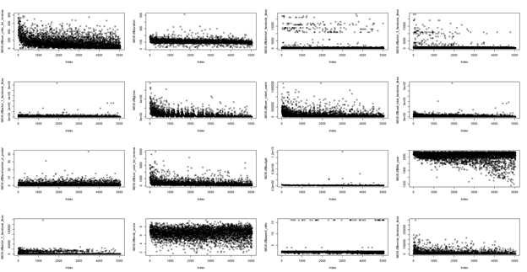
Erroneous Data
The erroneous data can be checked looking at the outliers and the negative values. We see what the variable represents, if the value is not possible for what the variable represents, that might be an error possibly.
In this case, there are no negative values but by evaluating the outliers of some variables, we found that some of the variables below are erroneous.
Erroneous variables:
actor_1_facebook_likes
cast_total_facebook_likes
Facenumber_in_poster
budget
actor_2_facebook_likes
Movie_facebook_likes

Slide 7
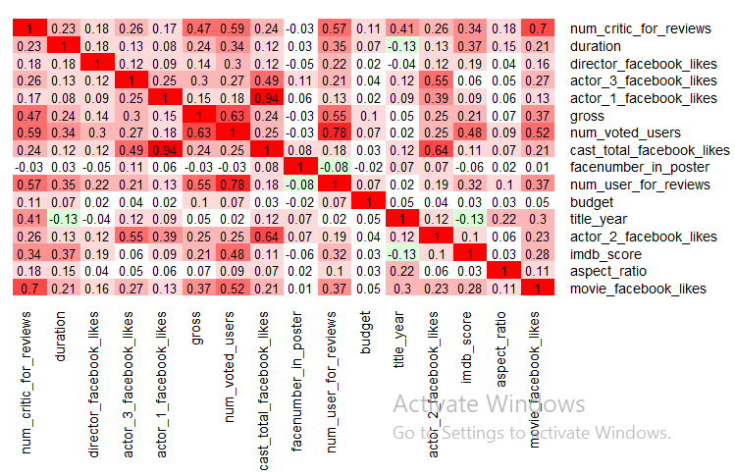
Correlation Table with Heatmap
Most correlation between variables are positive (correlations range from 0 to 1)
- The majority of the relationship between variables are either very weak (0 - 0.19) or weak (0.2 - 0.39).
- Some of them have moderate (0.4 - 0.59) or strong (0.6 - 0.79) relationship like number of voted users and number of users for review. However, this relationship is not strong enough to exclude one of the variable.
- The pair of variables having the strongest correlation is actor_1_facebook_likes and cast_total_facebook_like with a correlation of 0.94

Slide 8
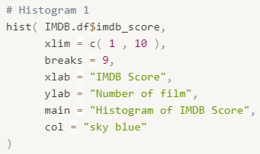
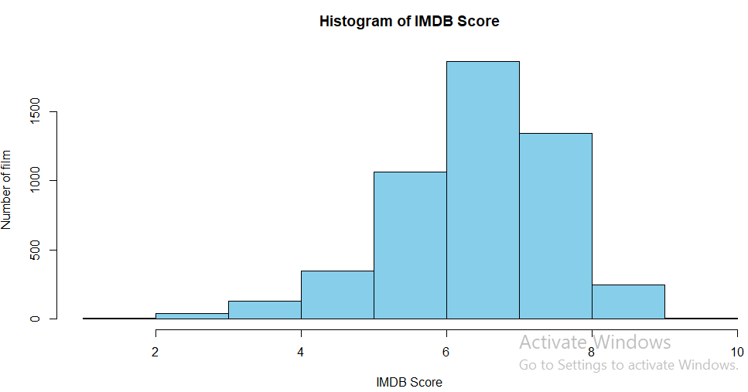
Histogram 1
Most films have an IMDB score from 5 to 8. Specifically, each score range (5-6, 6-7, and 7-8) have more than 1000 films.
The IMDB score range with the largest number of films is 6-7 (1,500+ films)
Only few films are listed in the IMDB top 250 thanks to their their high score (above 8). Furthermore, the number of films reach 9 and above is significantly low

Slide 9
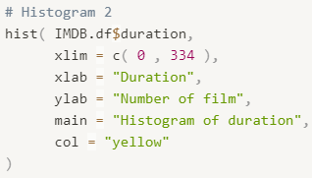
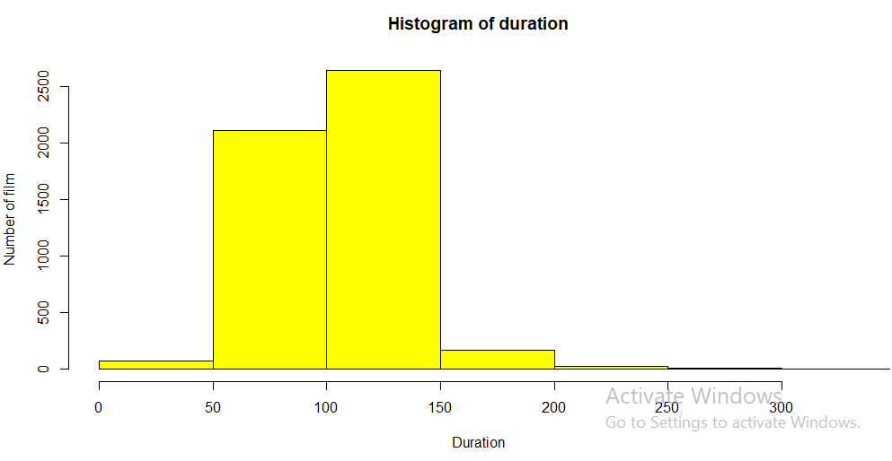
Histograms 2
Out of 5043 films in the database, more than 4,500 have a duration from 50 to 150 minutes. This means 90% of the films are 50 to 150 minutes long.
For the remaining movies, some of them either have a duration below 50 minutes or between 150 and 200 minutes.
Very few movies have a duration of more than 200 minutes

Slide 10
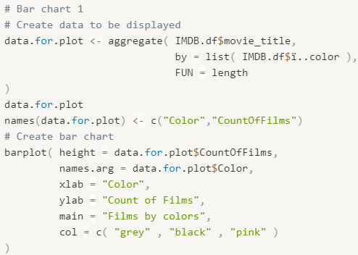
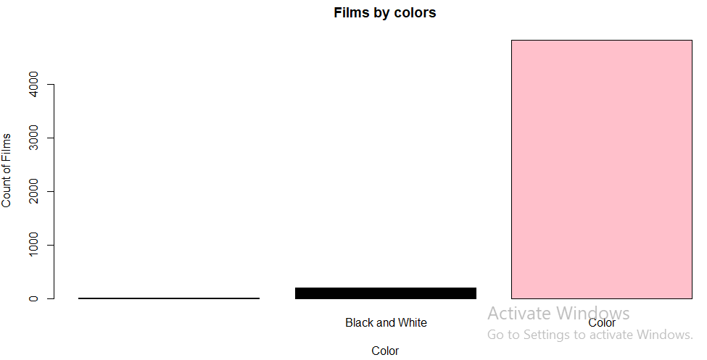
Bar Chart 1
⇒ The number of colored films is 23 times the number of Black and White films. To be more specific, there are 4815 films are in color while only 209 are in Black and White.
⇒ 19 records have missing data. This means 19 films in the dataset don’t have color information

Slide 11
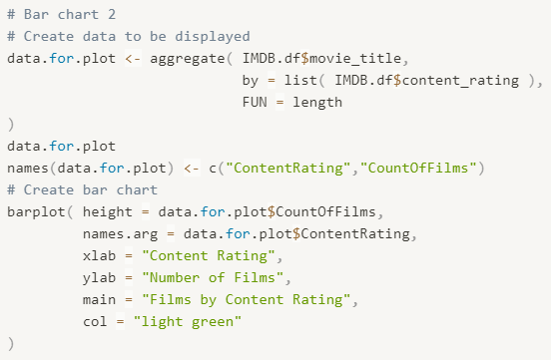
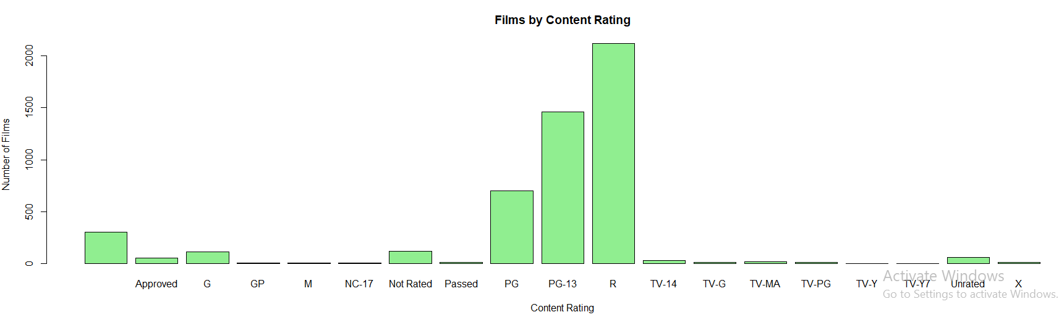
Bar Charts 2
⇒ The content rating category having the most films is: R (2000+ films), followed by PG 13 (1,500+ films), and PG (500+ films). In addition, these numbers are significantly high compared to other categories.
⇒ 329 films have missing data in terms of content rating

Slide 12
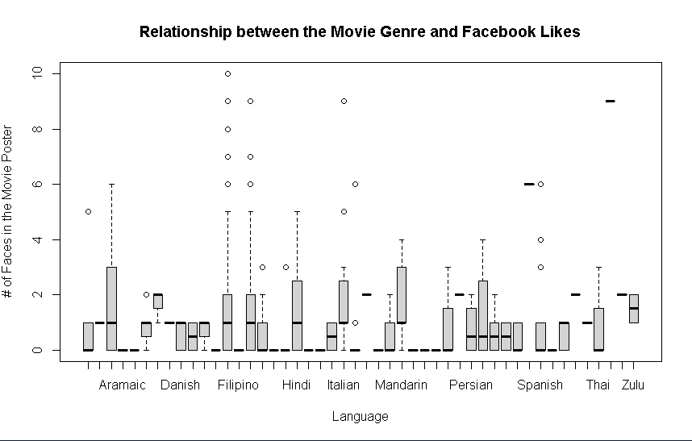

Box Plot 1
It looks like there is a very low correlation between Language and the # of faces in movie posters when looking at the box plot
The data points for the # of faces in Filipino films tend to be very skewed

Slide 13

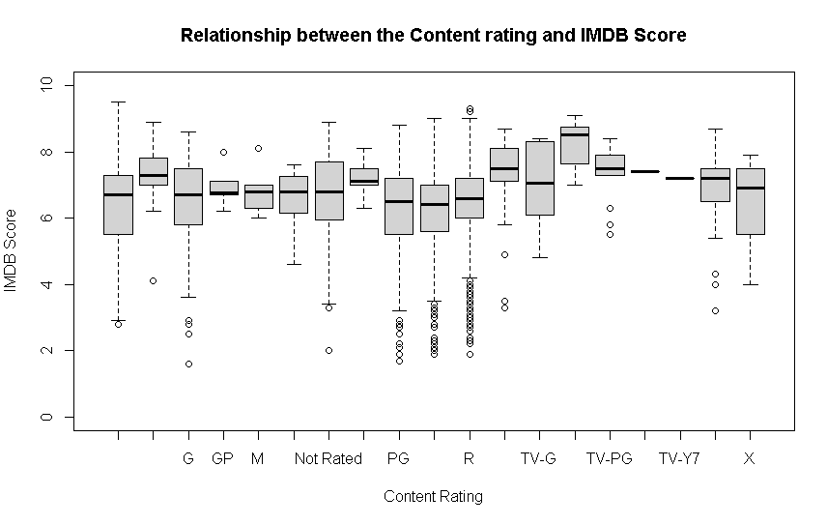
Box Plot 2
It seems that a lot of movies that are rated PG or R tend to have really poor IMDB ratings
The data seems highly skewed for PG and R rated movies
Its shown that the average for a lot of these rating are between 6 - 8 by looking at the box plot

Slide 14
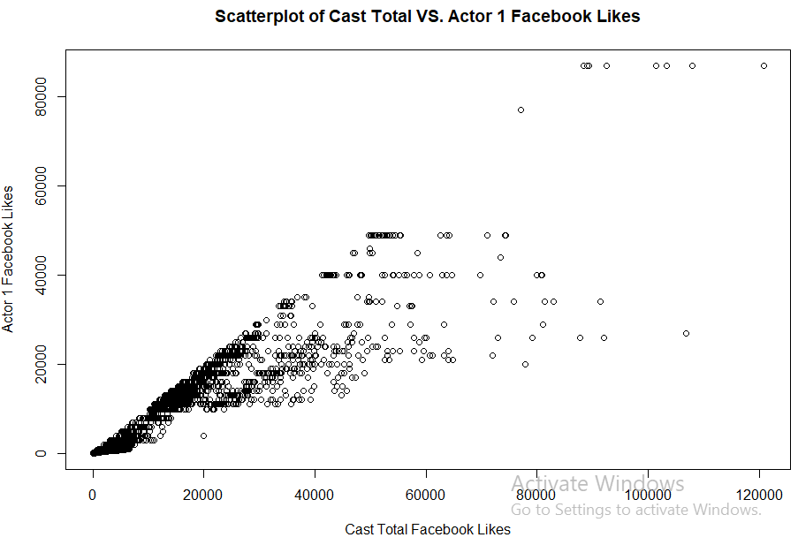
Scatterplot 1
The scatterplot on the right demonstrates the relationship between Cast Total Facebook Likes (x-axis) and Actor 1 Facebook Likes (y-axis)
By looking at the graph, we can inferred that there is a VERY STRONG, POSITIVE relationship between the 2 variables. ( the correlation is 0.94 according to the heatmap we did earlier)
Note: Some outliers have been removed from the graph to better illustrate the relationship between the 2 variables

Slide 15
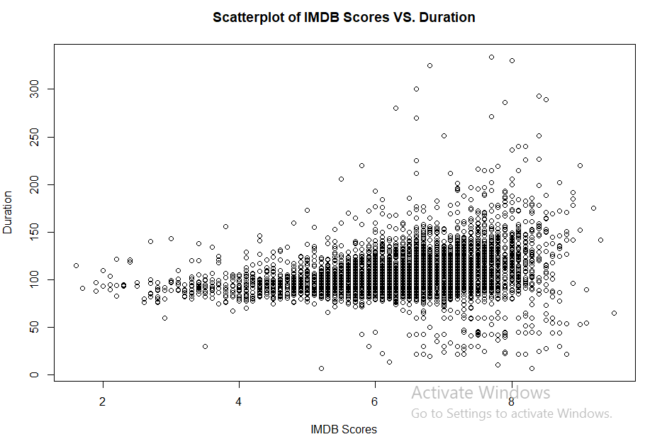
Scatterplot 2
This scatterplot shows the relationship between IMDB score and movie duration. By looking at the graph, we can conclude that there is a WEAK, POSITIVE relationship between the 2 variables.
Note: Some outliers have been removed from the graph to better illustrate the relationship between the 2 variables

Slide 16
Handling Missing Data
Variables with large number of missing data
Method 2: Replacement
2.1: replacing missing data with median
summary(IMDB.df$budget)
-> there are 492 records missing budget and the median of the remaining values is 20,000,000
2.2: Replace the missing values using the median of the remaining values.
IMDB.df$budget[is.na(IMDB.df$budget)] <- median(IMDB.df$budget, na.rm = TRUE)
summary(IMDB.df$budget)
-> Use median() with na.rm = TRUE to ignore missing values when computing the median.
Variables with small number of missing data
Method 1: Deleting rows with missing values
IMDB.df <- read.csv("IMDB Movie Dataset.csv")
summary(IMDB.df$duration)
-> for example, for duration variable, only 15 out of 5043 records are missing so we can delete
IMDB.df <- IMDB.df[!is.na(IMDB.df$duration), ]
dim(IMDB.df)

Slide 17
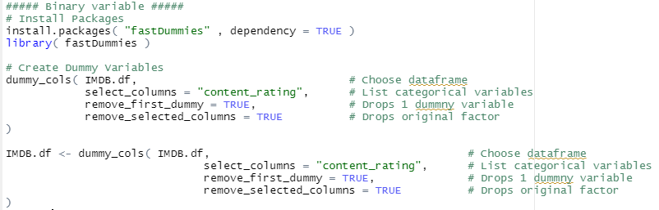
Binary Dummy Variables
We successfully create Binary Dummy Variables for Content Rating with the code below. The result can be found in the following slide.

Slide 18
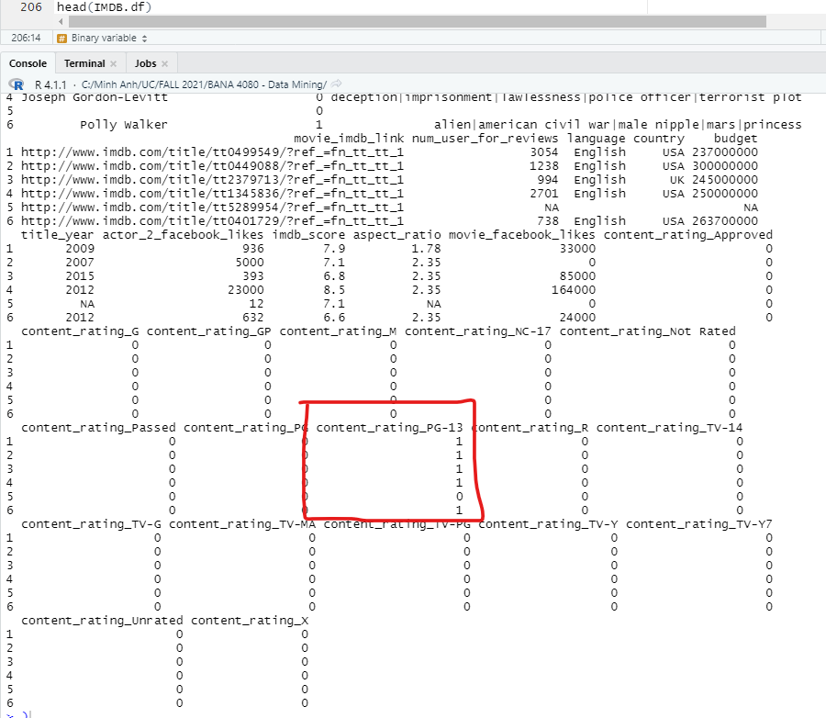
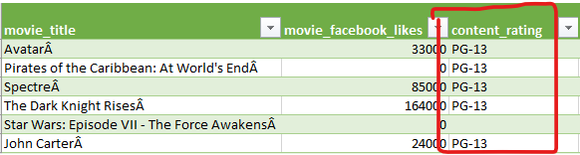
Binary Dummy Variables (cont)
The left photo shows the first 6 movies in the .csv file. The right photo shows the first 6 movies in RStudio after creating Binary Dummy Variable.
By looking at the Content Rating information in both photos, we can see that the code is accurate.

Slide 19
Conclusions
Here is some insight we gathered from the EDA:
There are 9 variables with outliers and 6 erroneous variables. This need to be taken into consideration when creating graphs such as scatterplot
Most relationships between movie information are positive (correlations range from 0 to 1). The majority of the relationship between variables are either very weak (0 - 0.19) or weak (0.2 - 0.39).
In terms of rating, most films have an IMDB score from 5 to 8. Specifically, each score range (5-6, 6-7, and 7-8) have more than 1000 films. There are very few movies that has rating >= 9. Only few films are listed in the IMDB top 250 thanks to their their high score (above 8).
The strongest relationship is Total Cast Facebook Likes and Actor 1 Facebook Likes with a correlation of up to 0.94. This fact is further proven by the first scatterplot we create.
It’s interesting to see that the number of faces in movie poster affect the movie rating. The less number of faces there are, the higher the imdb score is
The popularity of the whole cast is highly correlated with the popularity of the lead actor/actress.

